Slide 1

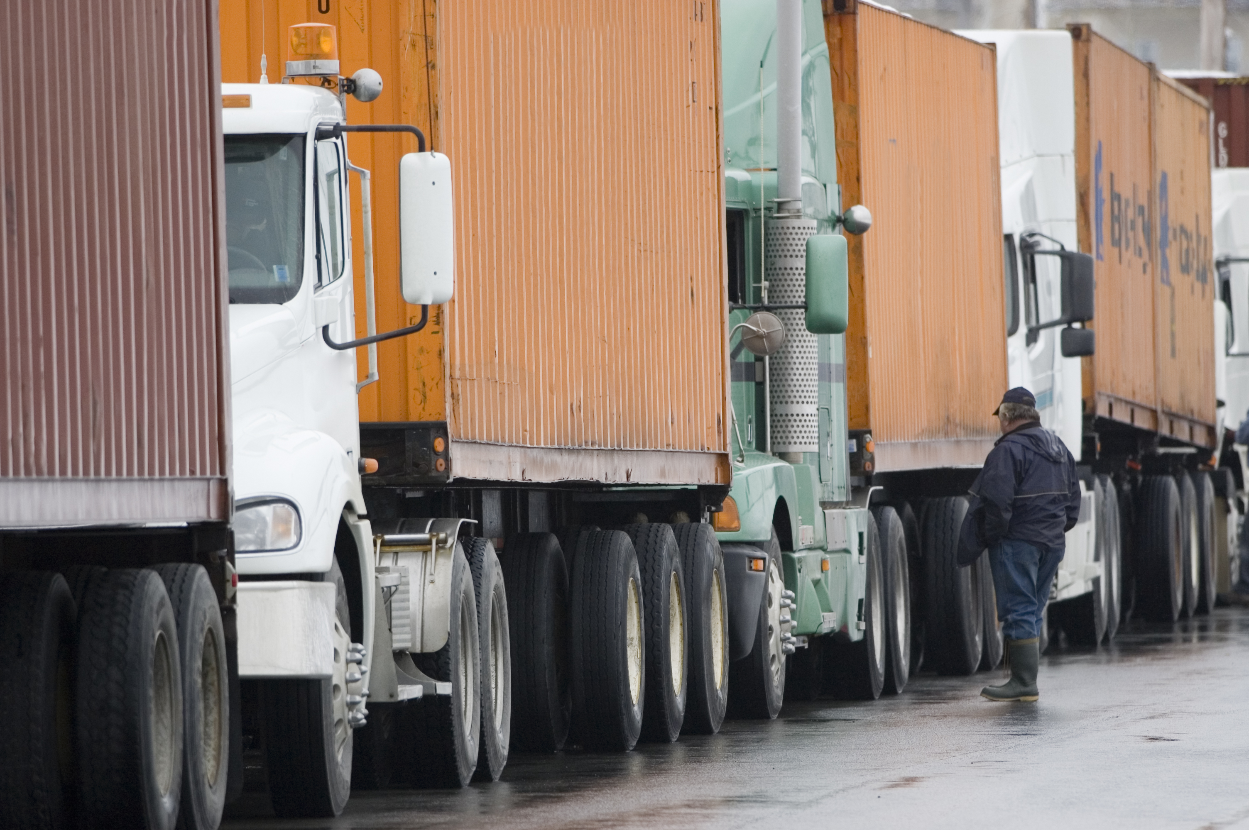
SESSION 4
Let’s Drive

Slide 2
Guiding Questions
Can you build a LEGO® robot and code a solution?
How do you change the program so the LEGO robot moves differently?
Outcomes
The team will build and code the LEGO® robot and then change the program.
The team will create a robot that can transport cargo.
Can you identify routes used for transportation?
How can you code the robot to transport cargo?
Notes:
Each session has Guiding Questions that can be shared to frame the session.
Session Tips
The team will learn about and use motor blocks.
The Ideas space can be used to write down the coding steps planned or which coding blocks the team will change.​
The team will create their first mobile robot that drives on the mat.
Make sure the team watches where the robot drives so that it does not fall if placed on a table.

Slide 3



Introduction – Let’s Innovate
Examples of Innovation
Ask the students to provide examples of Innovation and record them here
Example of Innovation
Example of Innovation
We used creativity and persistence to solve problems.
Extension
Notes:
Introduction
Go Team
(10 minutes)
Read the definition for teamwork to the team.(see page 5)
Talk about what teamwork is. Have the team provide examples of this Core Value.
Extension: Have everyone draw a picture of an example of teamwork on the Core Values page in their Engineering Notebook.

Slide 4


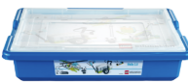
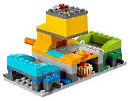
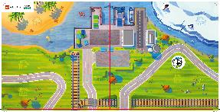
Task 1
You need…
Open the WeDo 2.0 app. Find your lesson.
Can you program the robot to move backward? Do a turn? Capture your ideas.
Change the existing program based on your ideas. Give it a test!
Classroom Projects:
Milo the Science Rover
Notes:
Tasks (20 minutes)
Launch the WeDo 2.0 app. Complete your lesson.
Can you program the robot to move backward? Do a turn? Capture your ideas.
Change the existing program based on your ideas. Give it a test!
Challenge
Can you add a cargo container to the robot?
Follow your plan and play your program.

Slide 5
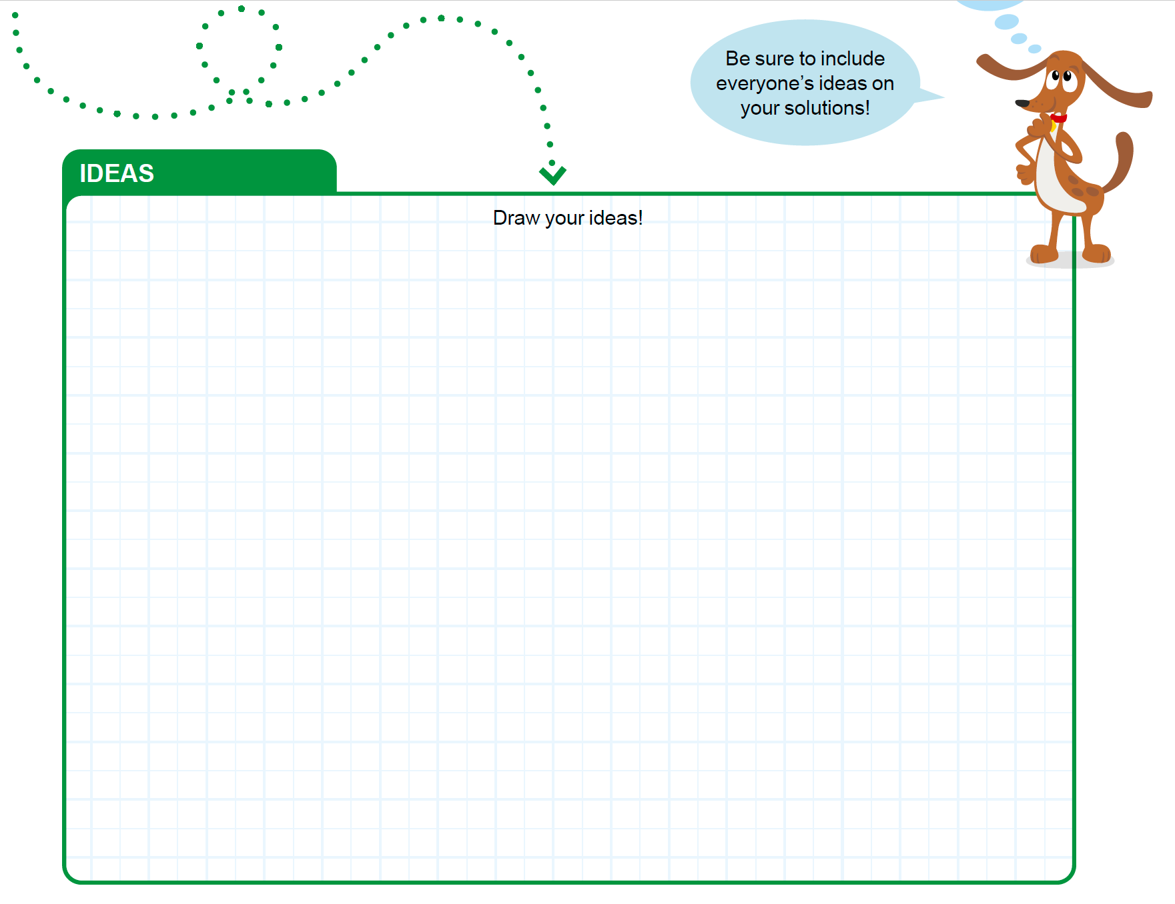
Task 1
Notes:
Tasks (20 minutes)
Launch the WeDo 2.0 app. Complete your lesson.
Can you program the robot to move backward? Do a turn? Capture your ideas.
Change the existing program based on your ideas. Give it a test!
Challenge
Can you add a cargo container to the robot?
Follow your plan and play your program.

Slide 6
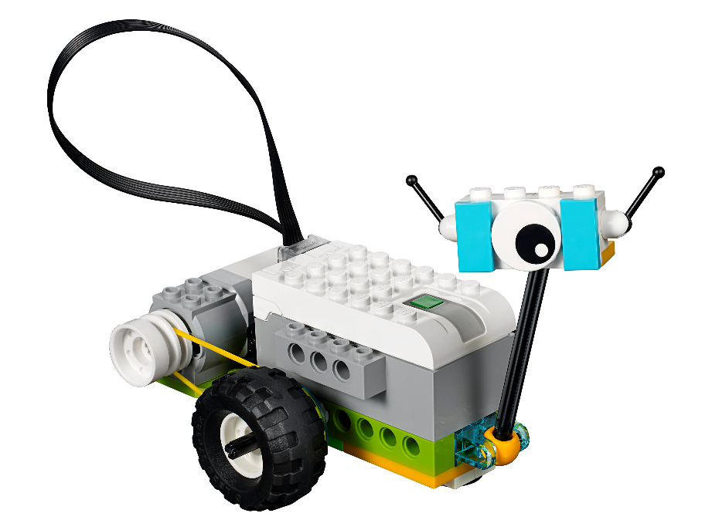
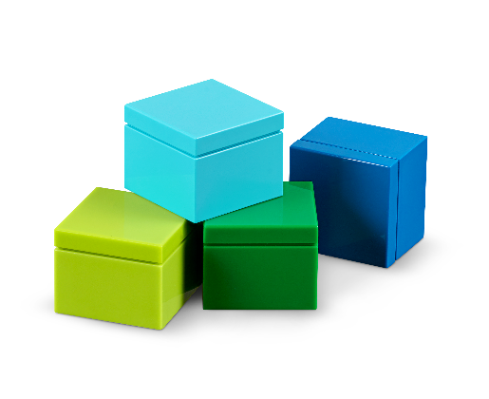
Task 1
Challenge
Can you add a cargo container to the robot?
Follow your plan and play your program.
Notes:
Tasks (20 minutes)
Launch the WeDo 2.0 app. Complete your lesson.
Can you program the robot to move backward? Do a turn? Capture your ideas.
Change the existing program based on your ideas. Give it a test!
Challenge
Can you add a cargo container to the robot?
Follow your plan and play your program.

Slide 7


Task 2
How is cargo
transported in and
out of my town?
What routes are
used to get cargo to
the sorting center?
Notes:
Tasks (20 minutes)
Chat about Ruby and Jacob’s questions.
Brainstorm, brainstorm, brainstorm!
Place the sorting center on the mat.
Use the mat to map out your planned path.
Create your program and run it.
Place the cargo delivered from the robot into the sorting center.

Slide 8

Task 2
Use the mat to map out your planned path.
Notes:
Tasks (20 minutes)
Chat about Ruby and Jacob’s questions.
Brainstorm, brainstorm, brainstorm!
Place the sorting center on the mat.
Use the mat to map out your planned path.
Create your program and run it.
Place the cargo delivered from the robot into the sorting center.

Slide 9

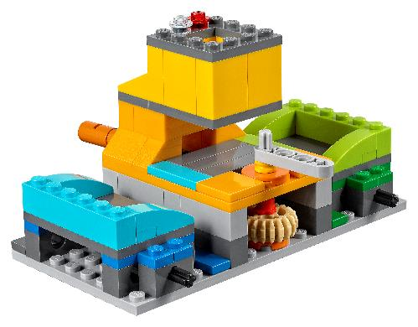

Task 2
Create your program and run it.
Place the cargo delivered from the robot into the sorting center.
Notes:
Tasks (20 minutes)
Chat about Ruby and Jacob’s questions.
Brainstorm, brainstorm, brainstorm!
Place the sorting center on the mat.
Use the mat to map out your planned path.
Create your program and run it.
Place the cargo delivered from the robot into the sorting center.

Slide 10
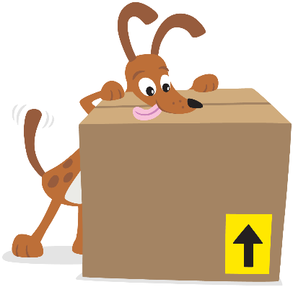
Share
How does a
freight driver know what
routes to use when
transporting cargo? Talk
as a team!
Share what you did in the session.
Show the coding skills you learned.
Explain how you changed the program.
Describe how cargo is transported.
Demonstrate how your robot transports cargo on the mat.
Notes:
Share (10 minutes)
Have the team:
• Share what they did in the session.
• Show the coding skills they learned.
• Explain how they changed the program.
• Describe how cargo is transported.
• Demonstrate how their robot transports cargo on the mat.

Slide 11

Optional Video:
You may wish to embed a relevant, age-appropriate video for your students here. See the Notes for an example.
Notes:
Choose a relevant, age-appropriate video for your students.
Here is one example from Tech Vision explaining How Amazon Delivers Packages So Fast: https://youtu.be/91jKeKuUaDM

Slide 12
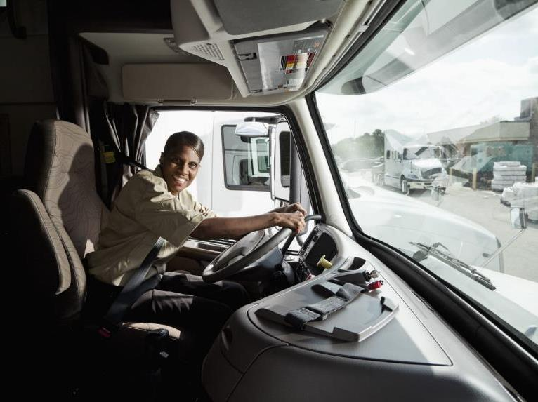
Career Connections
Freight Driver
Role:
Moves cargo from one location to another.
Notes:
Ask the children to reflect on where they might like to travel as a freight driver.

Slide 13
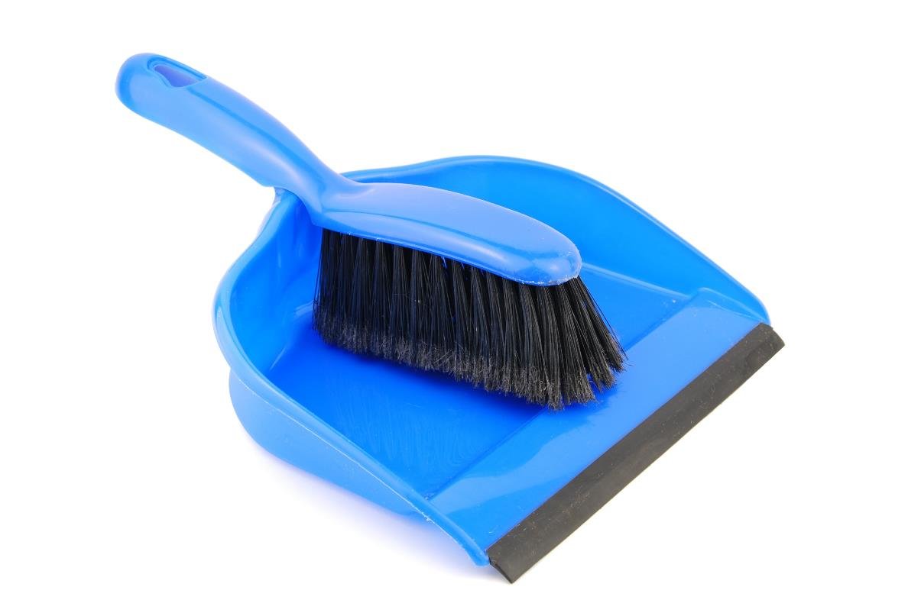
Clean Up
Notes:
You may wish to play a video or song during clean up time Link on GoNoodle: https://family.gonoodle.com/activities/clean-up. Link on YouTube Kids: https://www.youtubekids.com/watch?v=ZJFk87ZsHn0 . Link on Youtube: https://youtu.be/ZJFk87ZsHn0
Cleanup Pointers
• The sorting center should stay assembled, but everything else should be taken apart.
• Check that the pieces from the LEGO® robot are returned to the LEGO set.

Slide 14
FIRST® and the FIRST® logo are registered trademarks of For Inspiration and Recognition of Science and Technology (FIRST). LEGO® is a registered trademark of the LEGO Group. FIRST® LEGO® League and CARGO CONNECTSM are jointly held trademarks of FIRST and the LEGO Group. All other trademarks are the property of their respective owners. ©2021 FIRST and the LEGO Group. All rights reserved.

